Slide 1

InterCos 31
Diana Marjanovic, Sophia Weißenberger,
Adrian Berger, Min Ho Kim

Slide 2

The Problem

Slide 3
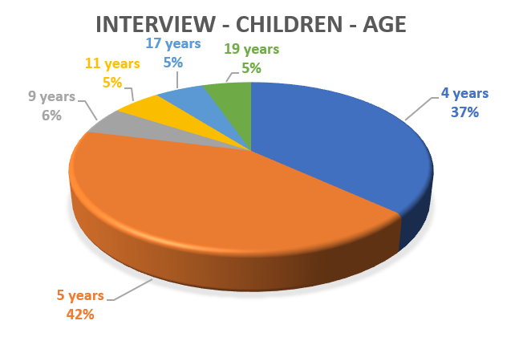
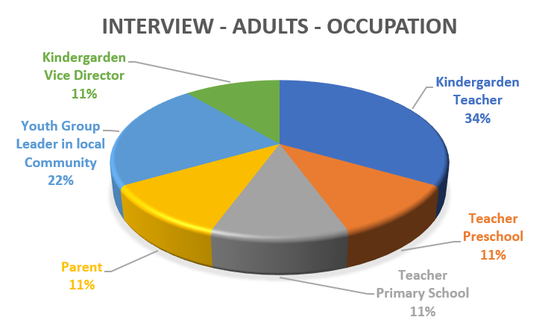
Stakeholder Interviews
Adults (pedagogues & parents)
Children (possible end users)

Slide 4
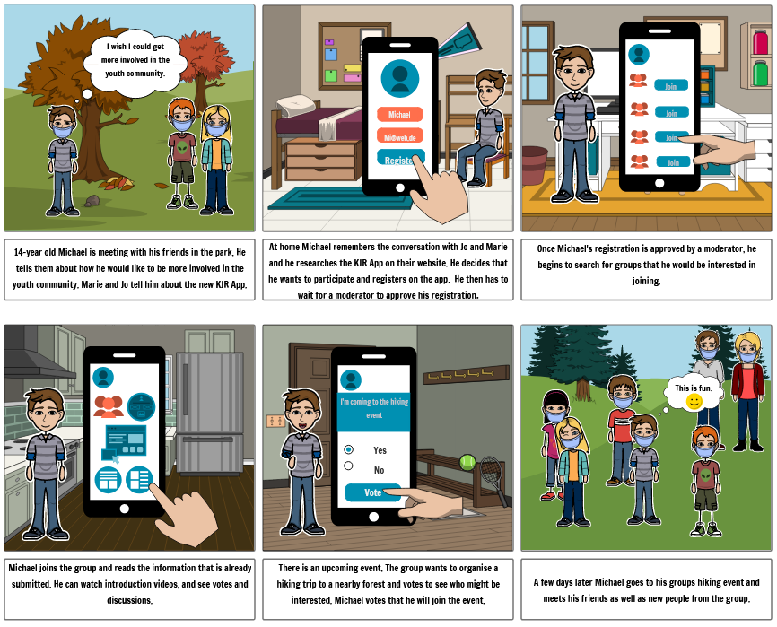
Our Challenge Contribution (Story Board)

Slide 5
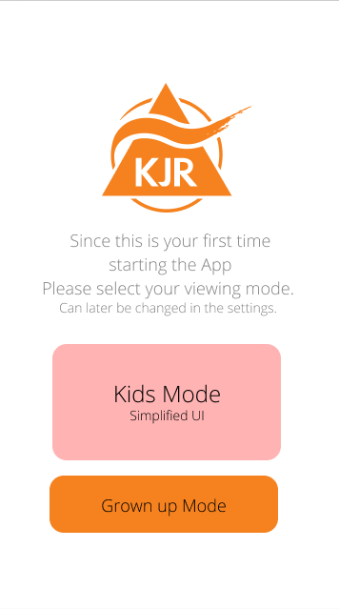
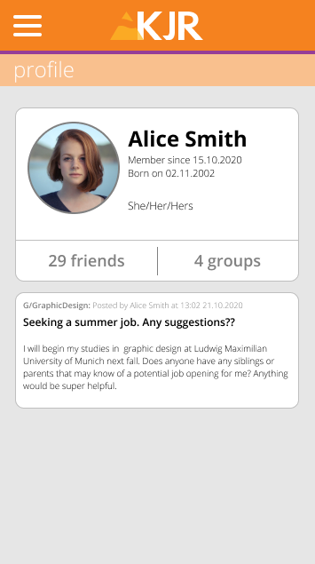
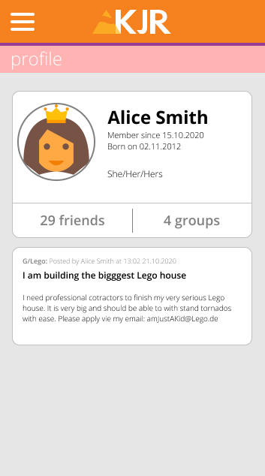
Prototype

Slide 6
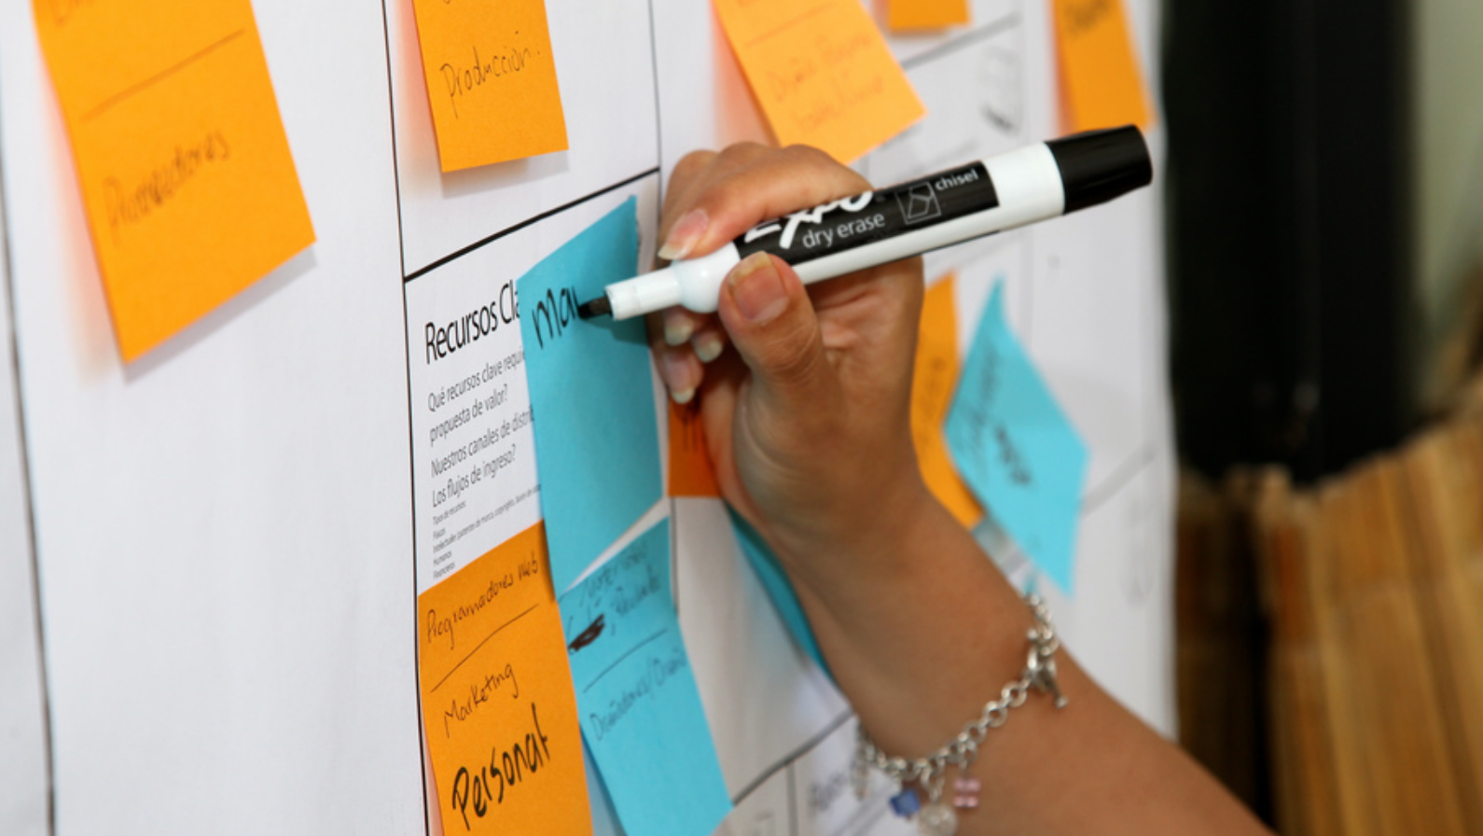
And now the business side of our contribution!

Slide 7

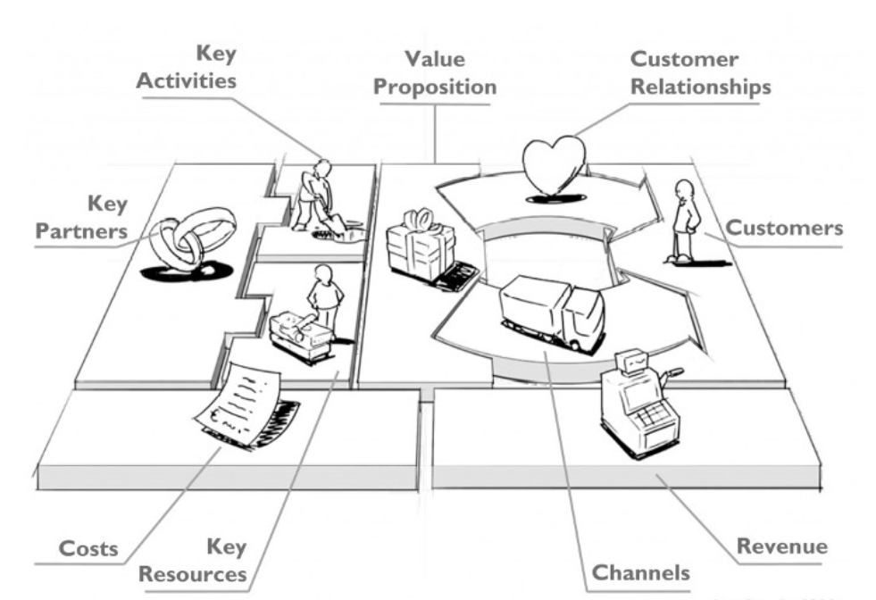
Business Model Canvas
What key activities require our value propositions? Our channels? Our customer relationships?
What kind of relationship does each of our customer segments expect from us, which we build and maintain with them?
Who are our main partners? Who are our main suppliers?
Who are our most important customers?
What key resources do our value propositions need? Our channels? Our customer relationships?
What value do we deliver to the customer?
Which customer needs do we satisfy?
What are the most important costs in our business model? Which key resources are the most expensive?
What channels do we want to use to reach our customer segments?
What value are our customers really willing to pay for?

Slide 8
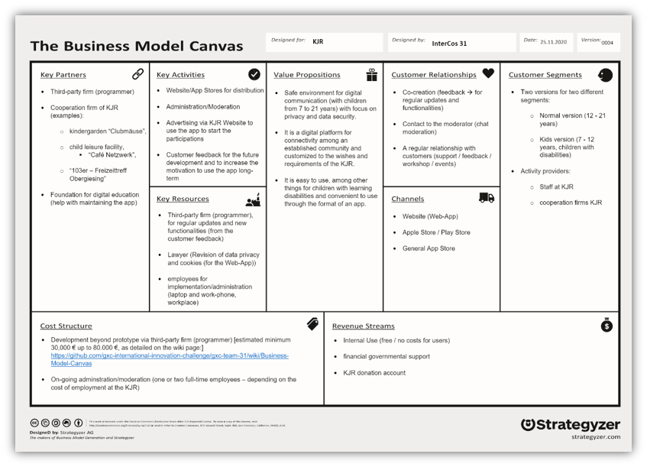
Business Model Canvas

Slide 9

Digital Prototype

Slide 10


Value to the challenge
Our prototype and underlying ideas have undergone a multitude of iterations and research based improvements
Based on target group interviews and reviews, including Educators, Children and Parents
Research gives insight into App demands from Youngsters and Educationalists, relevant beyond scope of this app
Prototype done with alpha phase. A development team could start programming process right now
Specify technical details according to your needs

Slide 11
What's next?
Does the research align with your target group ?
Key areas of Prototype meet expectations?
Define specifications
Conduct more research in your specific target group
Focus on features that are releveant too you
Hand Project over to Software Developer

Slide 12




Take Away
Diana
Adrian
Sophia
Min Ho
It was a very good experience to work with KJR as organization and to develop something together.
It is important to get to know the team. It was very good that we all searched for contact to each other from the beginning.
It has been very interesting for me to meet other students from other countries and learn about them.
Working in an interrnational team is a very usefull experience, timezones matter
Having a real Challenge with real data is the motivation makes getting results satisfying
Get to know the team. You will meet often either really early or late in the evening because of the time difference, so get to know each other and make it fun.
I loved to get to know other cultures.
I liked the experience to work with the KJR in this challenge. Normally university projects are for fictional end users and it was a good experience.
It was my first time working on a virtual collaborative project (probably for most of us) and I feel lucky to have been able to participate in an international effort to effect real change.
I would have loved to have studied abroad in Munich, but this was nice too, getting to know some folks across the pond even in the midst of a pandemic.

Slide 13
The Before After Team
Tips for Teams following in our footsteps
Understand the Problem and the environment that allowed yours to arise in the first place
Focus on Strengths and keep the feature creep light
Communication Initialization establish multiple channels as early as possible

Slide 14
References:
https://ut11.net/de/blog/dein-geschaftsmodell-kompakt-der-business-model-canvas/
business model canvas people - Bing images

Slide 15
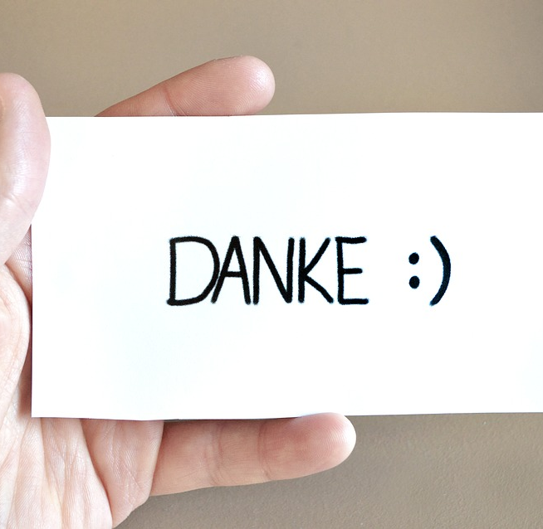
Thank you for your time

